Slide 1

Health Survey Analysis 9/12/2021 Toby Anderson

Slide 2
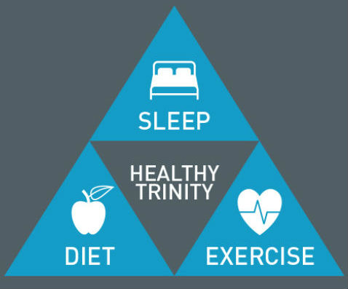
Problem Statement
Can we predict disease risk from lifestyle factors, such as diet, sleep, and exercise?

Slide 3


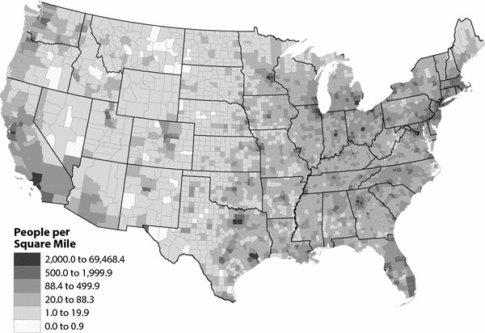
About The Data
Nearly 10,000 participants
National Health and Nutrition Examination Survey (NHANES).
Sampled from multiple counties in the US

Slide 4
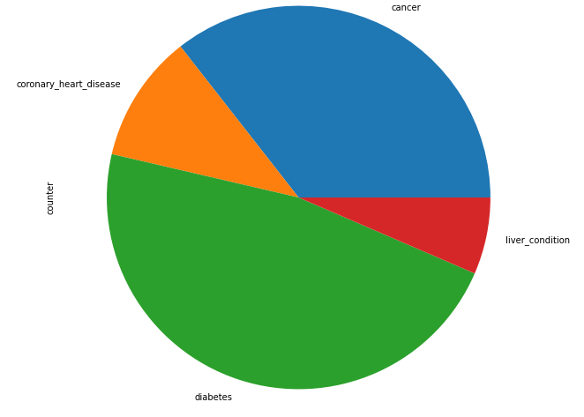
Prediction Targets
Targeting Diseases:
Cancer
Liver Condition
Heart Disease
Diabetes

Slide 5
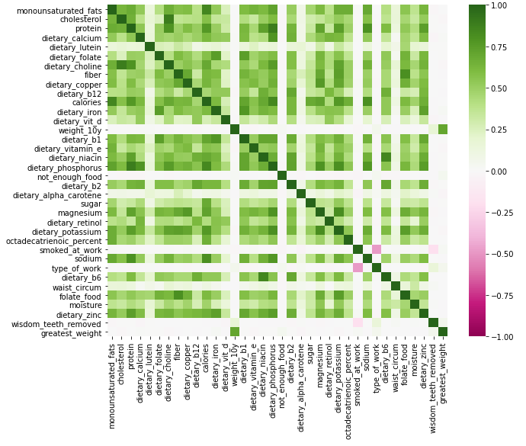
Explanatory Variables
Over 200 lifestyle factors identified:
Dietary Factors
Sleep Quality
Drug/Alcohol use
Physical Activity

Slide 6
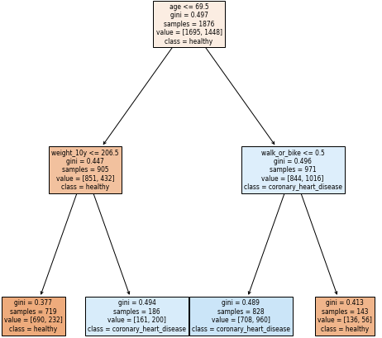
Heart Disease Decision Tree
Interpretation:
For younger people, weight is the most important factor to predict heart disease
In older people, staying active can protect against heart disease

Slide 7
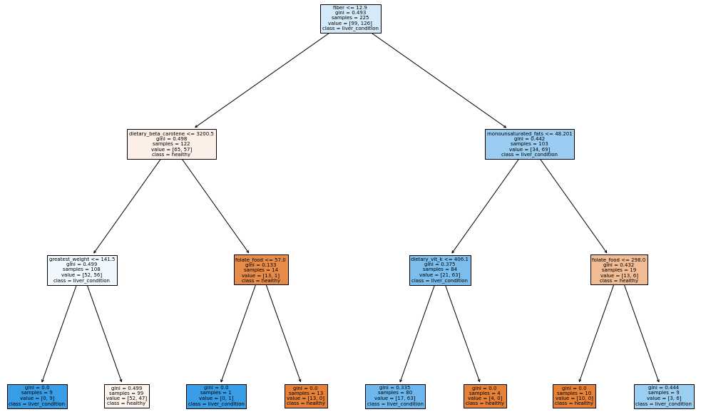
Liver Condition Decision Tree
Interpretation:
For high fiber eaters, eating more monounsaturated fat and vitamin k reduced risk
For low fiber eaters, high beta carotene and folate reduced risk.

Slide 8
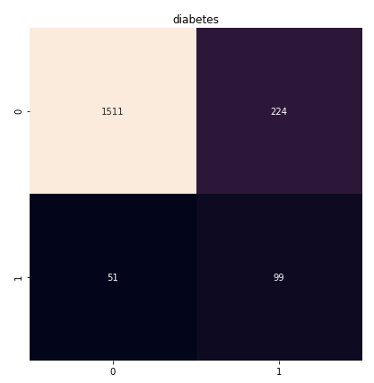
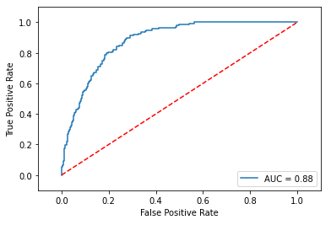
Diabetes XGBoost

Slide 9
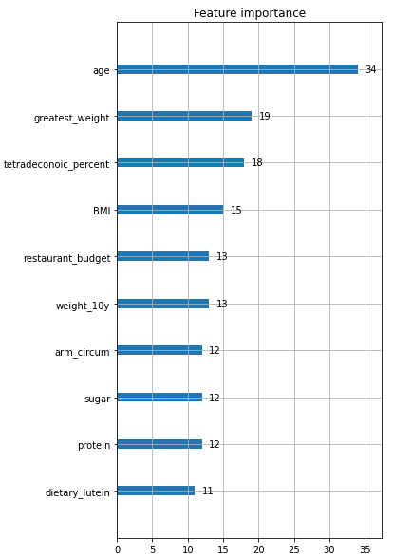
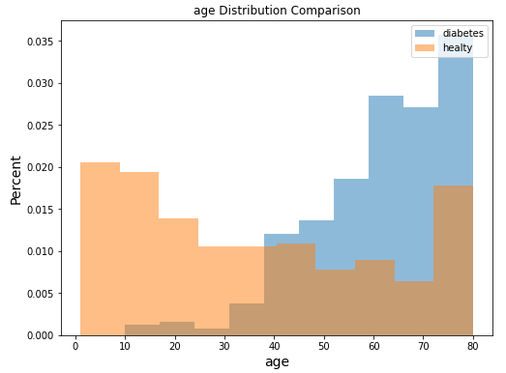
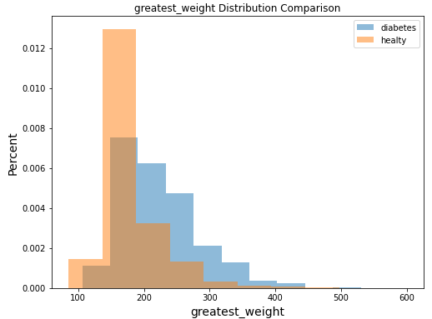
Diabetes XGBoost

Slide 10
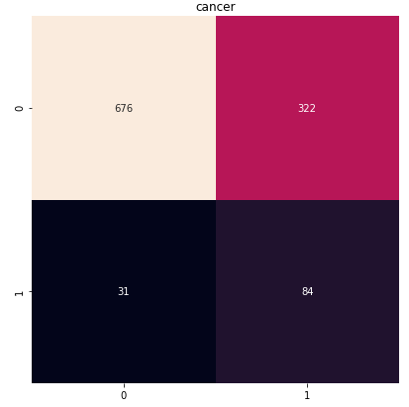
Cancer Naïve Bayes
Precision | 0.21
Recall | 0.73

Slide 11
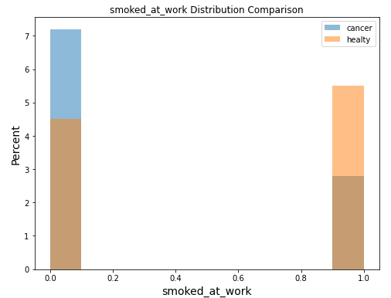
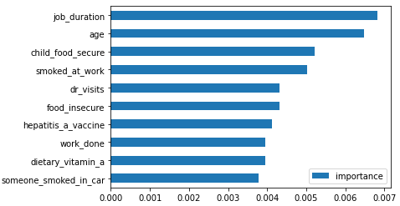
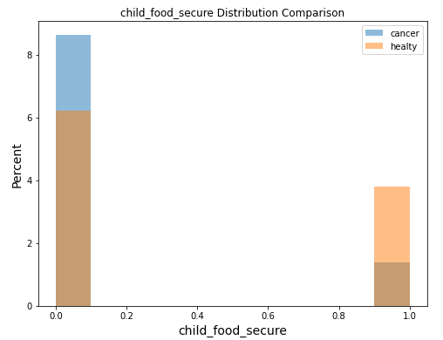
Cancer Naïve Bayes

Slide 12




Unexpected Results
Sleep quality and duration were not major factors.
Exercise Intensity was not a major factor
Macro diets, such as low carb, high fiber, or high protein were not impactful
Smoking had mixed results

Slide 13




Conclusions
Age is the most important factor in determining disease risk.
Physical Activity
lowers heart disease risk
Eating more Beta Carotene and Monounsaturated Fat decreases Liver disease and Diabetes risk
Food insecurity and smoking increased cancer risk

Slide 14
Questions?

